Slide 1
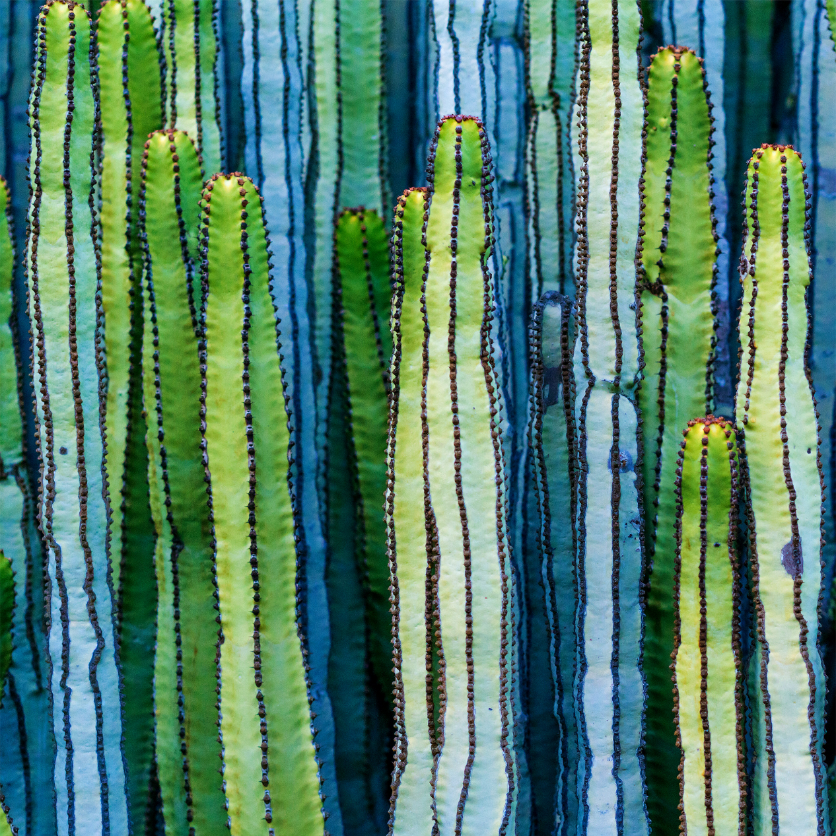
Design Sprint #2 Kickoff
ISEM 502 – User Centered Design
February 25, 2017 – In-person session

Slide 2

Agenda
WARMUP: Get Going
Rules of the day (2 mins)
Progress Check (Where are we?) (5 mins)
Techniques overview (3 mins)
Review Problematization Diamonds (5 mins)
Action Sketching (30 mins)
CONVERGE: Interface Generation
Silent Critique (10 mins)
Group Critique (10 mins)
Professor’s Super Vote (10 mins)
Wireframes (60 mins)
DIVERGE: Solution Generation
Job Stories (30 mins)
8-Ups (aka Crazy Eights) (20 mins)
Storyboards (30 mins)

Slide 3

WARM-UP
40 minutes

Slide 4
9 RULES OF THE DAY
Everyone participates
Have one conversation at a time
Withhold judgement of each other's ideas UNLESS constructive critique is part of the exercise
Get up and draw
Be comfortable
Be easy on people, tough on ideas
Be present – keep tech use to a minimum
No HiPPO complexes
No “yes, but…” … No one likes Buts.

Slide 5



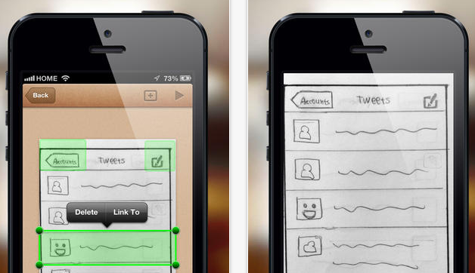

PROGRESS CHECK
Understand
Diverge
Converge
Prototype
Test
14 Days
21 Days
14 Days
Sprint #1
Sprint #2
Sprint #3

Slide 6
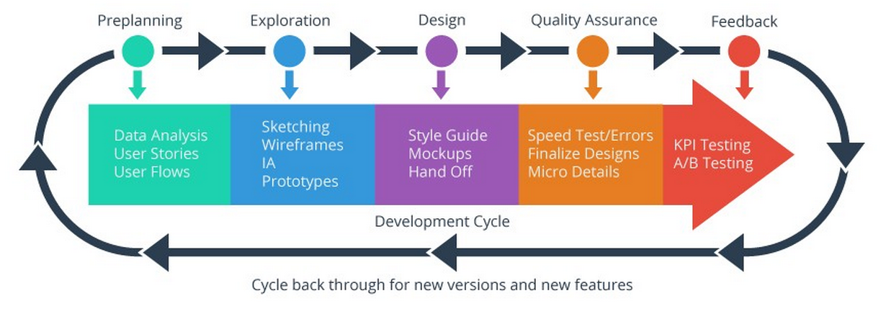
Process Overview
Notes:
While typically you do some preliminary prototypes BEFORE writing out your style guide and making mock-ups. In this class, we’re flipping that, because of the way class time in person is scheduled.

Slide 7
TECHNIQUES OVERVIEW
Techniques are enduring, but processes differ.
We are using a PERSONA-DRIVEN DEVELOPMENT PROCESS in this course.
But! There are other options. Here is a non-exhaustive list of other processes of doing user-centered design:
Scenario-based design
Participatory design
Action Research & Design
Expert design (also known as “God” or “Deity” design)
Agile/Scrum Sprints

Slide 8
SKETCHING
We are going to warm up with some scribble sketching….For each sketch, you have 20 seconds.
Draw the following items:
A clothespin
A doorbell button
The act of typing
A fingerprint
A pinky ring
Electricity
The last bite of a donut
An evil eye
A smartwatch
A hug

Slide 9
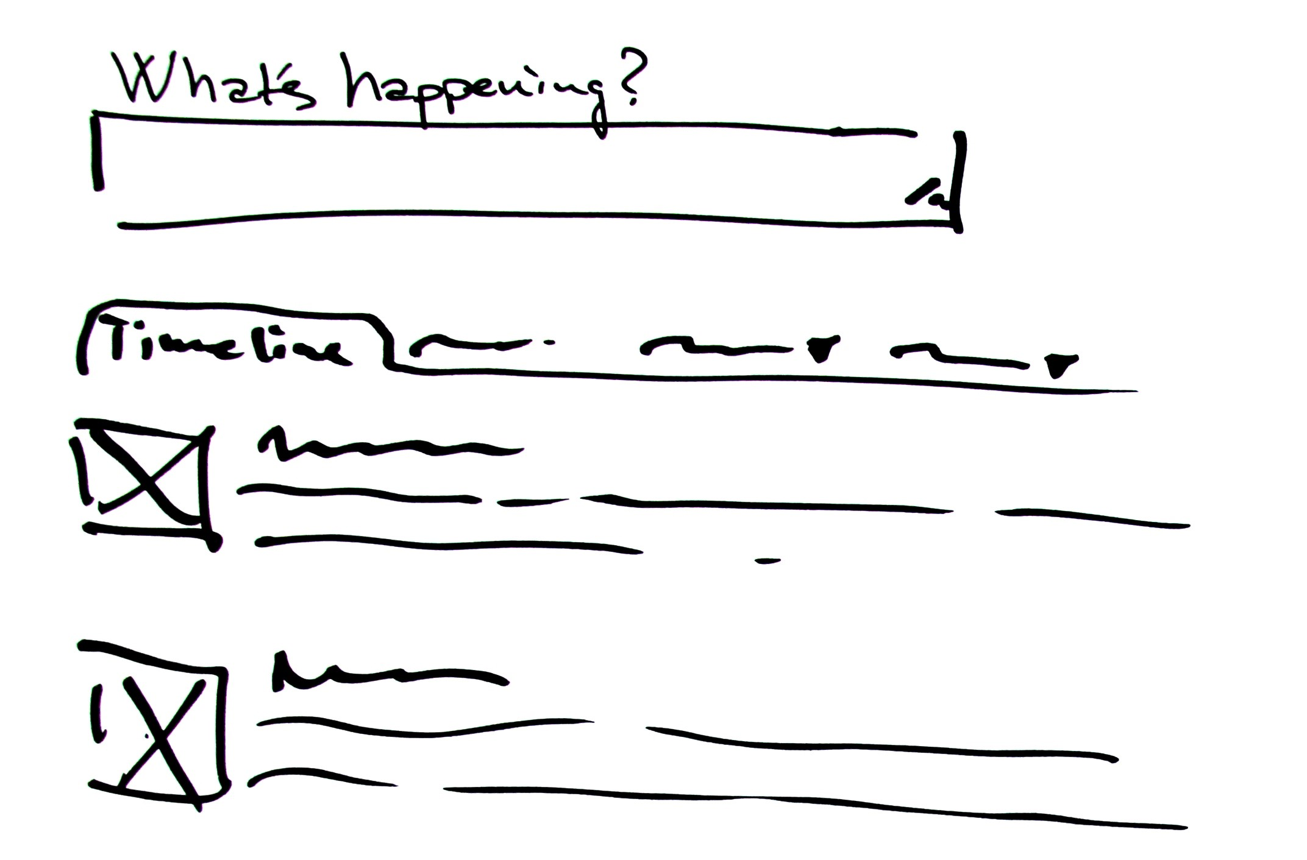
Scribble Sketching
Rapidly sketching out ideas – anywhere, anytime – in order to capture the essence of an idea.
Notes:
They should be done rapidly,
They should serve as a means of capturing impressions or critical ideas “on the fly” or “in the moment”
When sketching you SHOULD:
Sacrifice detail and fidelity to speed (similar to note taking)
With practice you can sketch without even looking at what you’re doing
Sketches of this nature don’t have to be beautiful, nor do they need to be legible or meaningful to others. They just need to capture an idea in a visual that is sufficient to remind you of what the idea was,

Slide 10
Group Project Problem Statement Review (5 mins)
Looking over Sprint #1 report, the Seven2 outcomes, and the personas.
As a group, given what you now know, (and given the feedback you got from Dr. T), consider whether or not your original problem statement made sense from a user perspective.
IF NOT: Work with the group to revise the wording of the problem statement, and write out the revised statement on a large format sticky sheet of paper. Affix this to the wall.
IF SO: Write out the problem statement on a large format sticky sheet of paper. Affix this to the wall.

Slide 11
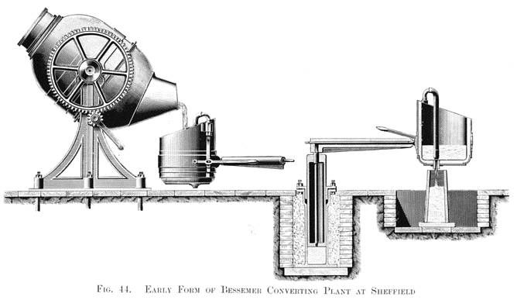
INTER(ACTION) STORYBOARDING: Daily Cuisine
Using your powers of user-focused design…
Sketch a one page visual narrative that analyzes and explains an everyday culinary task*.
*Based on task you drew from the action deck ** No Erasing allowed!
Notes:
Using your powers of user-focused design, you will visually depict the various actions, sequences, tasks and behaviors in a one-page visual narrative that allows you to analyze and explain a common, everyday culinary task.
Consider all the steps, including tools, equipment and ingredients. Represent the activity from a variety of perspectives, showing the various stages, sequences and events. Focus directly on the process of the activity, thinking through all the subtleties of behavior rather than the expected outcome
Processes can be sketches as a single view, as a linear overview, or as a time elapse set of panels. You choose!

Slide 12


Slide 13
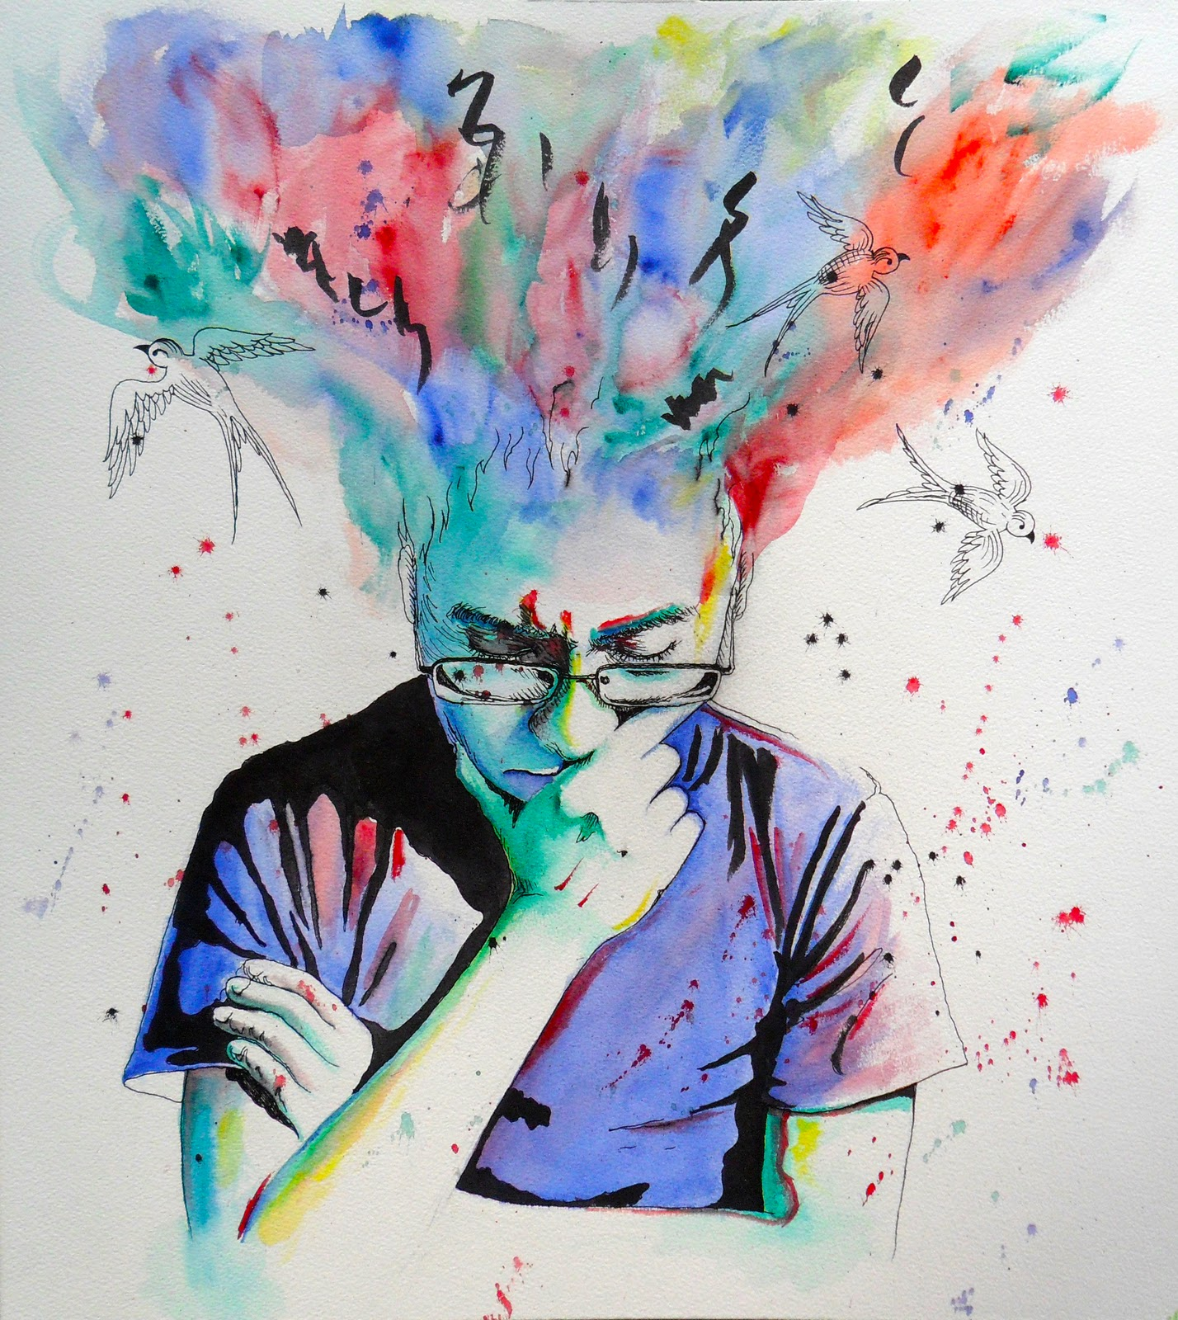
DIVERGE
SOLUTION GENERATION
(80 minutes)

Slide 14
Scribble Sketching
Practice and repetition help you develop a ‘critical eye’…
Practice: You learn to pull out the essential idea from what you are thinking, seeing, or doing
Repetition: Helps develop scribble sketching into a habit

Slide 15
Job Stories (30 mins)
Start with the high-level task or job the user is attempting to accomplish
Break that job down into smaller tasks, or smaller jobs.
For these smaller jobs discuss how users solve the problem now. Craft one or more job stories that investigate the causality, anxieties, and motivations of what they do now.
On a large sticky note, write: When _________, PERSONA wants to _________, so that _____________
Fill in the blanks: When _(event happens), I want to __(motivation/desire) ,__ so that __(outcome)__
Each team should share their job stories with the entire class.
CAVEAT: DO NOT focus on the feature; don’t forget about the WHY

Slide 16
8-Ups (20 mins)
Review the group materials so far, focusing on the Job Stories; Rule of Seven outcomes (i.e. guiding principles), the Personas, and the user problem identified in Sprint 1
Take 8 sheets of grid paper.
You will be given 8 sessions of 40 seconds each to draw a completely different solution to different aspects of your project’s problem.
When Dr. T. yells “Switch!” move to a fresh sheet of paper, until all 8 of your sheets are filled in.
Share your results with your team (tape/magnet to the whiteboard walls), taking no more than a minute to describe your 8-up grid.
REPEAT the entire process one more time. You’re encouraged to steal, modify, expand on each other’s ideas!!!
CAVEAT: DON’T take too long on any one idea – keep moving on to the next ones. DON’T start a discussion yet on any of the ideas.

Slide 17
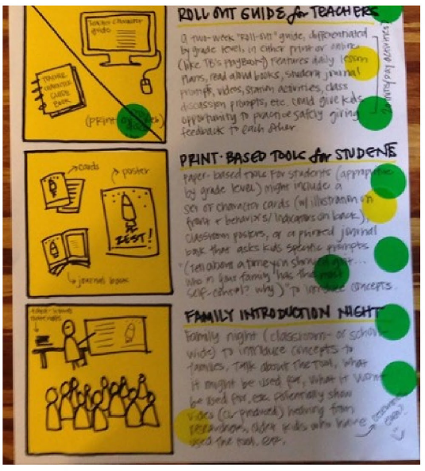
Storyboards (30 mins)
Take a minute to review the job stories you created earlier, alongside your personas and your outcomes from the Seven² assignment.
Stick three sticky notes along the left side of a large sheet of paper, leaving room for text on the right.
Draw out your scenario(s), considering human-human interactions, not just human-device or human-system interactions.
Add a small text caption to the right of each frame to describe what’s happening.
CAVEAT: DON’T include too many screens and not enough humans. DON’T write too much text. DON’T sign your name.

Slide 19

CONVERGE
INTERFACE GENERATION
(90 minutes)

Slide 20
Silent Critique (10 mins)
Using Magnets or Painter’s tape, put everyone’s storyboards up on the walls.
Take a sheet of stickers.
Go around individually, reading the storyboards and attaching stickers to the storyboard frames whose ideas you think are best. You can vote for your own ideas, and there’s no limit to how many stickers you can use.
Watch as some ideas start to ‘stand out’ from the overall collection, as they collect a cluster of stickers which form a kind of heat map of the most interesting ideas.
DON’T be stingy with stickes.

Slide 21
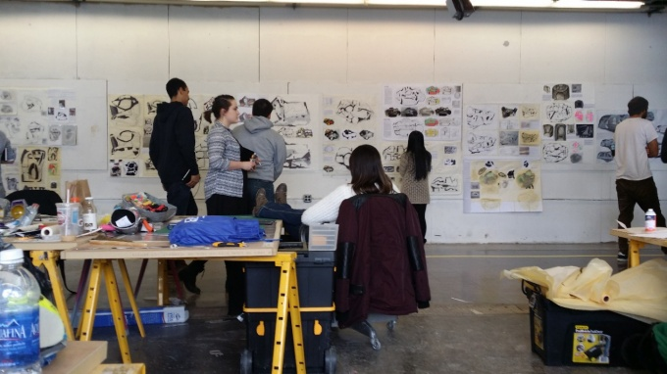
Group Critique (10 mins)
Each group should gather around their collection of storyboards.
Go around the group and ask what they liked about each storyboard.
Briefly (if desired) go over any concerns or issues. Note these on a the appropriately-colored sticky note (see next slide). Stick this onto the storyboard (or just next to or below it).
Ask the person who created it if anything needs more explanation, giving them the opportunity to talk through it. They are free to pass if everything was clear.
DON’T include only screenshots without telling the user story. DON’T write too much text.
Notes:
Image from: https://www.google.com/url?sa=i&rct=j&q=&esrc=s&source=images&cd=&cad=rja&uact=8&ved=0ahUKEwjNlr2WuarSAhXKRCYKHWzTCpoQjRwIBw&url=http%3A%2F%2Fap.buffalo.edu%2Fabout-us%2FCome-to-buffalo%2Flearn-by-doing%2Ffirst-year-studio-experience.html&bvm=bv.148073327,d.eWE&psig=AFQjCNG8MwK-Re3agWqHwuX4JUv00GlO0g&ust=1488084548953975

Slide 22
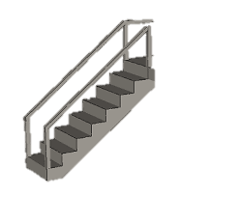

Steps
Idea
Comment/Note
Open Question
Sticky Note Color Coding
Use the appropriate color for your comment, suggestion, or critique
?

Slide 23

Professor T.’s Super Vote & Explanation (10 mins)

Slide 24
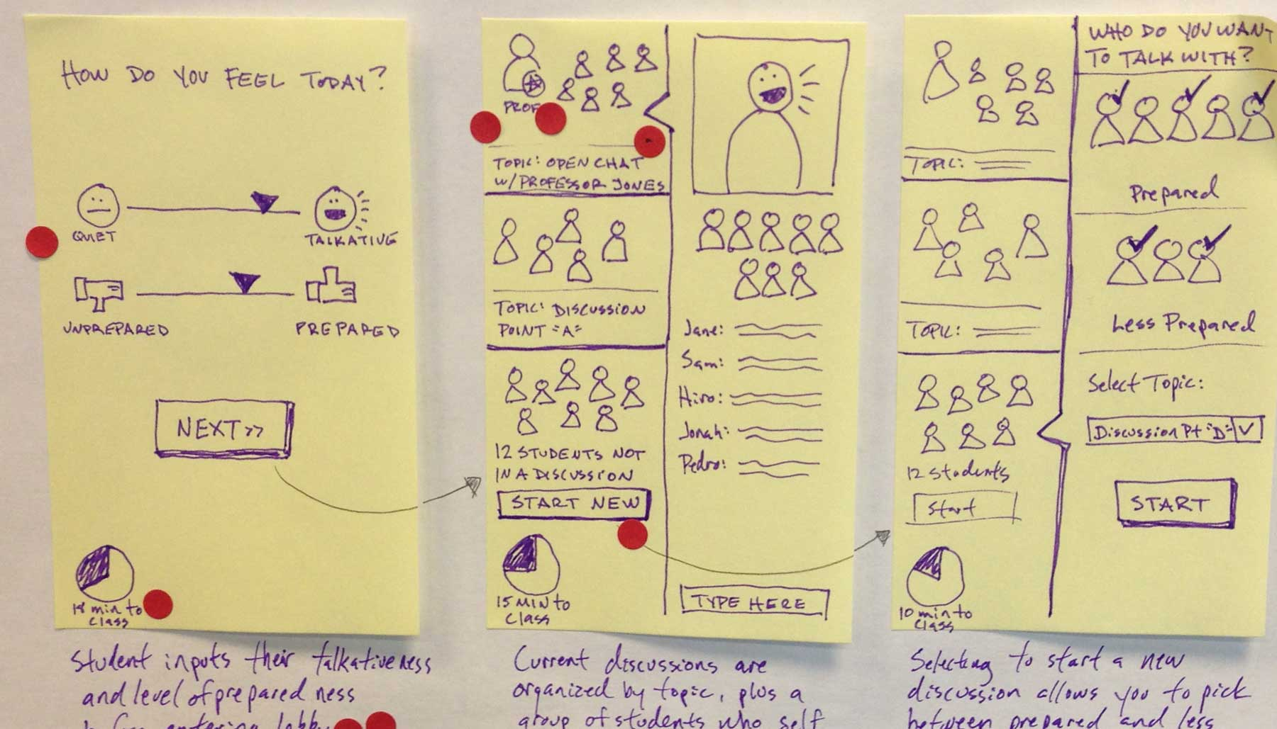
Wireframes
Rough Sketches of the flow through the experience of your product via screens
You strive for a minimum viable version of your final comprehensive product
Don’t worry about perfection – Focus on what the basic screens will do
Sketch fidelity should be low
Focus on the Happy! Path…Don’t worry about errors or ‘edge’ personas yet

Slide 25
Wireframes - Technique (45 mins)
Use the pre-drawn interface template sheets made available to you today
OR
Use several large sheets of either post-its or graph paper
Draw out wireframes of all the core persona’s interactions through the entire experience journey

Slide 26

REMINDERS & NEXT STEPS

Slide 27


REMEMBER!
USERS are your primary stakeholder
To get assessed positively by Dr. T., your design reports need to speak from the USER’S perspective, NOT yours as designers!

Slide 28
NEXT STEPS
Monday Feb 28 Remote Class: Intro to Prototyping
Work on Solo Work – Case Study #1 Analysis Paper
Read articles on prototyping (to be uploaded Feb 28)
Monday March 7 – NO CLASS (Dr. T. travelling to SIGCSE)
Upload work product from Sprint #2 kickoff
Read articles on design principles (color; complexity; information design)
To be uploaded March 9-10
Start working in your GP on Sprint #2 deliverables
Design Sprint #2 concludes March 19

Slide 29
UI Design Guidelines (Shneiderman, 1987, 1998, …, 2010)
Strive for consistency
Cater to universal usability
Offer informative feedback
Design task-flows to yield closure
Prevent errors
Permit easy reversal of actions
Make users feel they are in control
Minimize short-term memory load
Notes:
Ben Shneiderman published UI design guidelines in 1987 in book “Designing the User Interface”.
Essentially the same guidelines have been in all editions of the book up to now.

Slide 30
UI Design Guidelines (Nielsen, 1995)
Visibility of system status
Match between system & real world
User control & freedom
Consistency & standards
Error prevention
Recognition rather than recall
Flexibility & efficiency of use
Aesthetic & minimalist design
Help users recognize, diagnose, & recover from errors
Provide online documentation & help

Slide 31
Details of Design Sprint #2 Report
Work product from face-to-face class time + other work done together outside of class
Content & image creation
Information architecture
Design & style guides
Polished wireframes
Prototype ideas
Due March 19 (might be adjusted by a few days if deemed necessary)

